Slide 1
Portal Essentials
Focus Area: Foundation
Notes:
KEY
Provide participants with administrative information
HOW
Welcome participants to the course
Briefly, introduce the course
Briefly, introduce yourself as the instructor of the course
Discuss breaks and lunch
Emphasize the importance of sticking to the schedule - starting on time so that the class can end on time
Explain that attendance during all sessions is mandatory to receive course proof of attendance
TIME
7 min

Slide 2
Training Overview
Group Workshop
Back-end
Front-end
Integration
Services
Content
Services
Advanced
Security
Widget Development
Widget
Extras
Targeting
Publishing
Container
Development
Foundation
Portal Essentials
Portal Technologies
Portal Tools
Portal APIs
Notes:
KEY
Introduce the CXP Foundation training and this module
HOW
Explain to participants that this is the start of the CXP Foundation training
Give an overview of each CXP training (Foundation + FE + BE)
Explain that this is also the beginning of the Portal Essentials module
TIME
3 min

Slide 3
Objectives
Learn the foundation concepts of Backbase CXP
Overview of the Backbase CXP logical architecture
Understand the Portal Model
Understand how the Portal Model is rendered
Understand how the Portal Model is secured
Notes:
KEY
Describe the module objectives
HOW
Tell participants that these are the primary targets for this module
Discuss each of the goals listed on the visual
TIME
2 min

Slide 4
Backbase Products
Portal Essentials

Slide 5
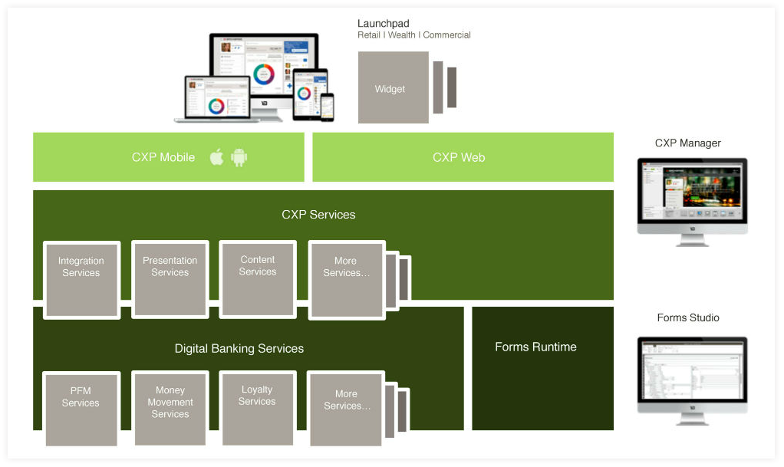
Backbase Products
Notes:
KEY
Present the list of Backbase products
HOW
Give a brief overview of each product
TIME
3 min

Slide 6
Intro to Backbase CXP
Portal Essentials

Slide 7



What is a Portal?
Gartner defines portals as personalized points of access to relevant information, business processes, and people
Brings value to three major audiences:
Provide end-users with a single, personalized point of access to relevant and authoritative information
Provide business organizations with a unified place to engage, support, learn from and respond to customers and other audiences
Provide IT organizations with an agile, scalable means to deliver Web applications, an environment to enable collaboration and a means to delegate responsibility to the business
Notes:
KEY
Define a portal
HOW
Feel free to provide examples of portals. Use your previous experience on portal projects
TIME
3 min

Slide 8
Our Vision: Empower Key Stakeholders
Customer
Superior User Experience
Multi-Device Access
Personal & Relevant
Business
Optimize Online Results
Lower Cost-per-Contact
Reduce IT Dependency
IT
Leverage existing Systems
Easy integration
Secure & Performance
Notes:
KEY
Present three major stakeholders of CXP
HOW
Describe the role and interests of each one in the portal context. Point out also that:
in general, portal users/customers wants some simple, seamless, easy to learn and fast.
Business members want time-to-market
IT wants agility without compromising risks.
TIME
3 min

Slide 9
Empower Key Stakeholders: Tools
Customer
Customer Tools:
Customization
Business
Business tools:
CXP Manager
Backbase
CXP
IT
Development tools:
Java, Maven
HTML, CSS, Javascript
Importer, APIs
Notes:
KEY
Show how CXP join up these stakeholders
HOW
Explain that CXP does not put the business in control over IT. It puts business users in control where it needs to be so that both parties can be more efficient.
Backbase Portal delivers the framework for IT to put the business in control.
Backbase CXP brings value to all three involved parties: customers, business members and IT
TIME
3 min

Slide 10
A Lean Portal
Existing solutions in the portal market provide sophisticated and versatile products but come with functional bloat and technical complexity
Companies want lean portals: simple, more cost-effective
focus on portal's primary proposition offering a personalized point of access to relevant information, business processes, and people
Rely on modern architectures and representational state transfer (REST)-oriented standards for interoperability
bringing customers faster time to value, without violating existing software standards, such as content management and analytics
Notes:
KEY
Define what is a Lean Portal
HOW
What are the advantages of BB CXP over other portals ?
Explain that REST will be explained later
TIME
3 min

Slide 11
What is a CXP Portal?
An enterprise web framework that empowers developers, business users, and end users
An aggregation platform with unified experience across these data and content sources
Notes:
KEY
Define CXP portal
HOW
Elaborate on provided definitions
TIME
2 min

Slide 12
CXP Portal: Technical Overview
Browser
Widget
Widget
Widget
Widget
Portal Client
Server
Portal Server Presentation Services
Portal
Integration
Services
Portal
Security
Services
Portal
Content
Services
Portal
Personalization
Services
Notes:
KEY
Explain the overall architecture of CXP Web
HOW
Browser part
widgets executing autonomously (as much as possible)
portal client lib: JS framework widgets rely on, communication with backend systems
Server part:
Presentation services: renders the model and provides necessary outcome
Other modules
Integration: integrating with other systems
Security: authentication and authorization
Content: delivering content
Personalization: Allow end users to personalize the portal
TIME
8 mins

Slide 13
Key Elements of Backbase CXP
A component model
Flexible rendering and support for multi-device delivery
Personalization
The ability to integrate with a wide range of technologies
Content services
Security administration
Targeting
Publishing
Notes:
KEY
Briefly, explain the table of contents
HOW
Explain that the component model is the most important one and everything else relies on this concept
Quickly go over the various modules
TIME
1 min

Slide 14
Portal Component Model
Portal Essentials

Slide 15
Backbase CXP Model
Model defines the structure of the portal
Used by Portal to render web pages
More abstract way to conceptualize your application
Portal model is stored in portal database
Portal model can be modified:
By business user, using CXP Manager
By developers:
Using Backbase command line tool
Programmatically, using APIs (REST, Java, JavaScript)
By end-users through personalization
Notes:
KEY
Define the portal model
HOW
Explain the concept of model
Give some examples of elements that belong to the portal model
Explain how the model is used and how it can be changed
TIME
1 min

Slide 16
Object Model Items
Portals, pages, containers, and widgets — collectively called items; form the structure of portal websites.
Users and groups — describe authorization for each item.
Templates — determine how pages, containers, and widgets are rendered.
Catalogs — contain abstract items that can be used across the Backbase CXP installation, or in a particular portal.
Links — contain pointers to items, other links, external URLs, or item states.
Tags — store keywords assigned to portals, pages, containers, widgets, or templates.
Features — make shared resources available to items.
Structured content types — define the underlying structure of reusable content items that are stored in Content Services and displayed by the structured content widget.
Notes:
KEY
Describe model elements
HOW
Briefly describe each element
TIME
2 min

Slide 17
Concepts of CXP Object Model
Page
Page
Page
Container
Container
Container
Nested Container
Nested Container
Nested Container
Widget
Widget
Widget
Widget
Widget
Widget
Widget
Widget
Widget
Nested Container
Nested Container
Nested Container
Nested Container
Nested Container
Nested Container
Widget
Widget
Widget
Widget
Widget
Widget
Catalog
Container
Container
Container
Widget
Widget
Widget
Widget
Notes:
KEY
Describe the interaction between components
HOW
Use the animation to describe how portal elements are interlinked.
Use examples to describe pages, containers, widgets and communication (e.g. A current account management page with accounts and transaction widget having some communication)
Present the concept of catalog for the first time
TIME
5 min

Slide 18
Pages
A portal is composed of one or more pages
Pages may directly include containers and widgets
Pages can be of two types:
Master pages: blueprint for pages
Pages: extend master pages
Notes:
KEY
Definition of page
HOW
Recap and explain difference between master pages and pages
Provide a couple of examples
TIME
3 min

Slide 19
Master Pages
Master Page
A blueprint for pages
Contains at least one manageable area
New pages are created based on a Master Page
Areas outside manageable areas are locked for editing
Manageable areas:
Available for editing on regular pages.
Locked
Locked
Manageable
Area
Notes:
KEY
Definition of a master page
HOW
Explain that a master page has an associated template and is designed the same way as a regular page by the addition of layouts, widgets, and content.
For example, you can enforce that all pages of a portal have the same header and footer by designing them in the Master page
TIME
3 min

Slide 20
Containers
Containers logically group other container and widgets
Containers have a layout defining the visual representation of a grouping
20
Notes:
KEY
Definition of a container
HOW
Explain what a container is
Explain why it is also called a layout in CXP manager
Provide examples of containers (e.g. carrousel, columns, tabs, decks)
TIME
2 min

Slide 21
Widgets
Widgets are the core of a portal’s functionality
Autonomous mini-applications
Cannot include containers or widgets
Notes:
KEY
Definition of a widget
HOW
Define widgets
Tell participants that widgets are where most of the business functionality lives
Provide examples of widgets for different sectors (retail: accounts, transactions, insurance: claims, and so on)
TIME
3 min

Slide 22
An Item
Item
Name
Item
Tags
Parent
Main meta
Extends
Properties
Item
(Portal, Page,
Container, or Widget)
Title
Properties
Template
My Portal
Context
Property X
Property Y
Children
Rights
Group1
SP1
Template
Item
Item
Item
Group2
SP2
Group3
SP3
Notes:
KEY
Describe the item model
HOW
Use the animation to explain that:
an item must have a context (either the server or a particular portal)
each item may have a parent (except portals)
each item can have one or more children (except widgets)
each item has main meta info (name, which must be unique, and tags)
each item can also have default (defined by the item type) & custom properties (defined by the developer, give an example or 2) that can be modified
template property: tells CXP how this item should be rendered
an item can extend from another item (for example, when enabling a widget from the server catalog into a specific portal, you create an extension of the base widget from the server catalog, and you store the delta, give examples)
an item can have rights, but rights are a separate object in the portal model, items are unaware of their rights (security)
when creating custom groups, you must base them on a predefined role
TIME
5 min

Slide 23

Item Cascade
Portal
Properties
Template
Page
Properties
Template
Container
Properties
Template
Widget
Properties
Template
Notes:
KEY
Describe the item model
HOW
Explain that:
each item has a set of properties (customizable) & a template (or sets of templates)
pages always belong to a portal
containers always belong to pages or other containers
widgets belong to containers or pages directly
TIME
3 min

Slide 24
Managing Items
An item can have properties (meta-information)
Name/value pairs
Typed (e.g. double, integer, string, ..)
Every item type gets a set of default properties
e.g. default landing page
An item can have optional custom properties
A user (depending on permissions) can set his own value to an item property (customization at the user scope)
Properties
Item
(Portal, Page,
Container, or Widget)
Title
Properties
Template
Property X
Property Y
Notes:
KEY
Definition of properties
HOW
Explain that items have different properties
Be prepared to give examples (e.g. columns widget has a ”# of columns” properties, while transactions widget has a ”# of elements per page” property.
Explain the concept of property customization
TIME
3 min

Slide 25
Items and Deletion
Deletions in Backbase CXP always cascade: children are deleted as well
Deleting a page deletes its containers and widgets.
Deletions in CXP cannot be undone
Notes:
KEY
Removing items
HOW
Explain that deletions are cascade and permanent
Present some risk-aware strategies
Making regular DB dumps
Unpublishing the page (stays in editorial env , but gone from live environment)
Hide an item (“soft” deletion)
TIME
2 min

Slide 26
Demo: CXP Manager
Let’s look at how the CXP Manager handles the concepts we have just discussed
Notes:
KEY
Present a demo cover the basic components of CXP
HOW
Conduct a demo in two distinct steps: Part 1: Using an existing portal to present basic concepts for the first time. Part 2: Creating a basic portal.
Proposed Steps
PART 1
Log into CXP Manager
Present the interface (left-hand side menu, and list of portals)
Show the Retail Demo portal (Retail Banking demo for Widget Collection 2.x)
Show the master page (header, footer, and manageable area)
Show the home page
Show containers and widgets used on this page
Use one of the columns container
Add a new column
Add an widget into the new column
Preview the portal home page
Emphasize that these steps are executed by typical business users and not IT members.
PART 2
Create a demo portal (suggested name ACME Bank)
Create a master page (Suggested name ACME Master Page)
It must extend from Launchpad if your are using a Launchpad-based Installation
It must extend from Blank Page and use the Retail Banking Demo Page Template if your are using a Widget Collection 2.x
This master page will have only one manageable area
Create a page (suggested name Credit Cards)
This page must extend your master page
Preview the blank page
It is a good opportunity to show the preview functionality
Tell participants that:
The content of the page is not relevant now.
The objective is to cover the creation of a portal.
Wrap up:
Tell participants that they have had the first contact with CXP manager. Also, they have seen fundamental elements of CXP: portals, pages, containers and widgets.
TIME
15 mins

Slide 27
Catalogs
Server Level – Enterprise Catalog (global space BBHOST)
Portal Level – Portal Catalog
Server
Level
ALL PORTALS
Pages
Containers
Widgets
Catalog
selection of items
Portal
Portal
Level
Pages
Containers
Widgets
Catalog
Catalog
Notes:
KEY
Show the concept of catalog and its scopes
HOW
Catalogs contain defined items.
Server level (called BBHOST in code)
Portal level (Manager can select which widgets are available within a specific portal)
Collection of widgets, containers, master pages on the server level. Any new created item first needs to be registered in the enterprise catalog.
You cannot have an item in the portal catalog that does not exist in the enterprise catalog.
From this, you can enable or disable that specific item for a given portal.
So the portal catalog is a selection of items from the enterprise catalog.
Once activated, you can instantiate items in your portal.
TIME
3 min

Slide 28
Inheriting Rules
Rules of inheriting properties:
Items in a portal catalog inherit properties from the abstract item in the enterprise catalog, unless someone explicitly sets a property.
Items instantiated in a portal inherit properties from the abstract item in the portal catalog, unless someone explicitly sets a property.
Rules of inheriting rights:
Abstract items in the enterprise catalog inherit rights from Portal Foundation.
Abstract items in a portal catalog inherit rights from the portal.
Instantiated items inherit rights from their parent (either a portal, a page, or a container).
Notes:
KEY
Explain how property inheritance works
HOW
When a user places a widget on a page, Portal Foundation effectively creates a new widget that extends the widget in the catalog.
The new widget inherits all properties from the extended widget. You can add custom properties, or modify the value of default properties
When an end-user personalizes the widget, for example by maximizing it or moving it to a different container, Portal Foundation extends the original object, applies the personalization, and stores the personalization in the database.
Both in the case of extensions and personalization, Backbase CXP only saves the changes (aka, the ‘delta’) between the instantiated item and the abstract item.
Rights inheritance is a different dimension (inheriting from server down to widgets, give example)
By default, you want to set your access rights on a portal level. But you can modify that on an item basis
TIME
7 min

Slide 29
Demo: CXP Manager
Let’s look at how the CXP Manager handles the concepts we have just discussed
Notes:
KEY
Present a demo that covers the concept of catalog scopes (enterprise and portal).
HOW
Proposed Steps
Enterprise Catalog
Log into the CXP Manager
Navigate through the enterprise catalog showing:
layouts, master pages, templates, content types, widgets, and features
Show search capabilities (filtering, sorting, text search and tags search)
Portal Catalog
Open the portal created in the first demo
Open its catalog and show to participants that it is almost empty (only with basic items)
Add three widgets into the catalog: content, columns, and navigation - footer (navigation for W2.x)
Portal Content
You don’t need to explain in details this part. Tell them that you are adding some banners and images into the portal.
Go to the portal content and upload all images from the Resources/Images folder of the material
Master page improvement
Open the previously created master page and:
Add the content widget on top of the manageable area
Change the content widget template to Image
Drag an image (suggestion: header-banner.jpeg)
Add the navigation widget into the page
We are using the content widget here o show how to use content services to get images, banners, and icons.
Page improvement
See the page that uses the recently created master page
Tell participants that the page has adopted the master page look and feel.
Change the page,
add a columns container (by default it has three columns)
add a content widget into the first column with some labels and an image (suggestion: banner-creditcard.png)
Preview the page
Wrap up:
We have seen how to manage the portal catalog and how catalog items can be used in pages.
TIME
15 min

Slide 30
Navigation and Links
The link item stores pointers to other items or external URLs
Navigation widgets use links to build navigation trees
Type | Description
Page | Refers to a page
External link | Refers to a URL outside CXP
Divider | Displays a divider in the navigation tree
Header | Displays a menu header in the navigation tree. Does not refer to a page itself, but can have children that do
Alias | Refers to a page that already has an associated link
Notes:
KEY
Links allow us to define navigation trees.
HOW
Describe each link type.
TIME
2 min

Slide 31
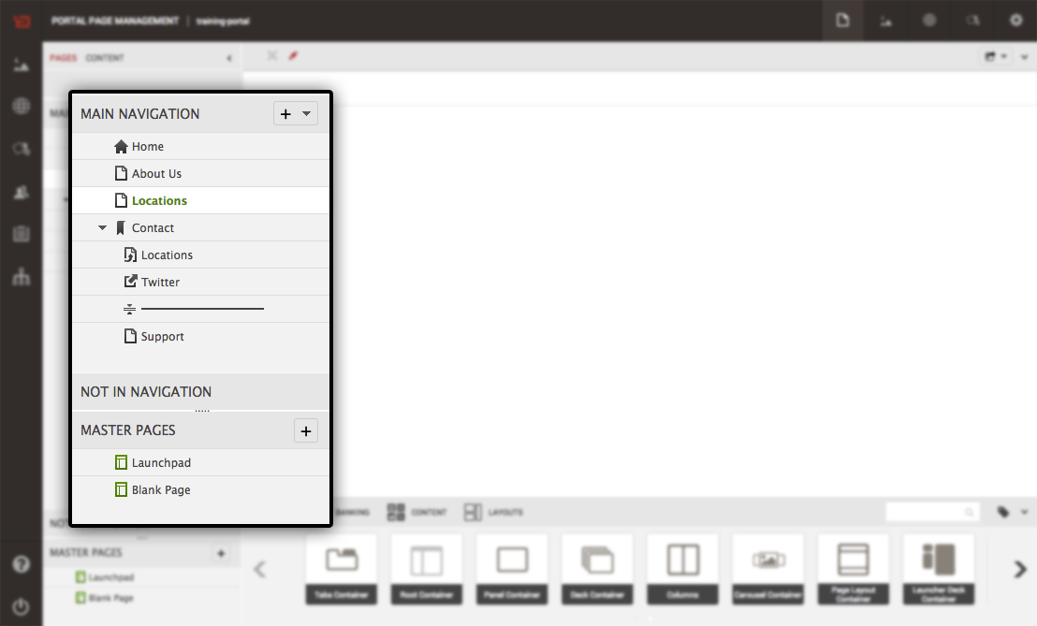
Links
CXP Manager creates a link for every new page and creates menus as shown in the image below:
Notes:
KEY
Give examples of links
HOW
Use the slide example:
1, 2, 8 - Page links — refer to portal pages. In CXP Manager each newly created page has a link automatically created.
Navigation items
3 - State links — links pointing to each state of a layout with navigation. Regarding hierarchy, a state link is a child of the link for the page where the tabbed layout is included.
4 - Header — in the example, labeled as Contact. A header is rendered as a title grouping a set of pages in your navigation tree. Headers do not point to items.
5 - External Link — in the example a link to a corporate Twitter page. External links point to URLs external to the portal as opposed to links of portal pages.
6 - Alias — in the example an alias of the Locations page. An alias points to the internal path (see Links, Hierarchical URLs and inheritance) of an existing portal page. The alias has an independent menu label, hierarchical and friendly URLs.
7 - Divider — adds as graphic element dividing items in a navigation menu; The presentation of this element depends on the style of the used navigation widget.
9 - Redirect — refers to a page link which might have been moved or deleted. It allows defining a specific HTTP status code to return if users request the outdated link. In the example, Expert Services redirects to page Support.
TIME
2 min

Slide 32
Root Links
Root links are menu headers that divide the navigation tree into smaller sub-trees
Root links:
Main navigation — contains links that should show up in navigation widgets.
Not in navigation — contains links to floating pages or pages that do not show up in navigation widgets. Floating pages are, for example, landing pages for a marketing campaign.
Master Pages — contains links that refer to the master pages available in the portal.
Root links do not point to pages, but to other links
Notes:
KEY
Explain the concept of root links
HOW
Describe each root link type
Explain you can create your own root links using the API
TIME
2 min

Slide 33
URLs
Link URL types:
Hierarchical: automatically generated, human-readable addresses pointing to links
Friendly: user-defined and easy-to-remember URL pointing to links
External: point to resources outside of a portal
Dynamic URLs
Can change the state of containers and widgets on a page
Contain dynamic URL parts that containers and widgets can use to change their behavior
The dynamic URL parts appear at the end of the normal URL after the identifier //
http://example.com/myportal/mypage//some/values/here
Notes:
KEY
Present different URL types
HOW
Explain the difference between hierarchical, friendly URLs, and external URLs
If time permits, open the properties of any page in CXP manager
Explain the concept of dynamic URLS and how they can be used
TIME
5 min

Slide 34
Links and Deletion
Deleting a link also deletes the referenced page
If other links refer to the same page, the following applies:
If another link refers to the same page, the page is not deleted
Notes:
KEY
Links and deletion
HOW
Remind participants that a link is created for each new page
TIME
2 min

Slide 35
Demo: CXP Manager
Let's look at how the CXP Manager handles the concepts we have just discussed
Notes:
KEY
Present a demo or propose an exercise that covers the concept of links.
HOW
Use the previously created portal. Here you can find the proposed themes and steps:
Page links:
Create a page in the main navigation section (e.g. Insurance).
Add a columns container
Add a content widget into the first column
Add some text and image (suggestion life-insurance.jpg)
External link:
Create an external link (e.g. Backbase) pointing to http://www.backbase.com.
Test
Preview the page and navigate through pages
Friendly URL:
Create a friendly URL for the insurance page (e.g. using the simple name ins)
Access the friendly URL using your browser
Not in navigation
Create a new page (e.g. ACME Card) with more information about the ACME card in the ”not in navigation” section
Edit the Credit Card page
Using the content widget inside the page, create a link to the ACME page
Test the portal
Show to participants that ACME Card does not belong to the list of navigable items but is accessible through the link
Dynamic Links:
Tell participants that dynamic links aggregate value to generic widgets, since they can receive parameters via URLs.
Change the Insurance page
Change the property title and writes the following text: This is the first parameter: Hello [$1:Content]
Open the page in the browser passing a parameter using the // identifier
E.g. http://localhost:7777/portalserver/acme-bank/insurance//John
Attention! Do not use parameters with spaces in this examples (space will not be rendered)
Wrap up:
Tell participants that we have covered different types of links and navigation elements.
TIME
10 min

Slide 36
Key Elements of Backbase CXP
A component model
Flexible rendering and support for multi-device delivery
Personalization
The ability to integrate with a wide range of technologies
Content services
Security administration
Targeting
Publishing
Notes:
KEY
Explain the table of contents
HOW
Explain that we are going to a new subject that explains how CXP allows flexible rendering (smartphone, tablets, desktops)
TIME
1 min

Slide 37
Rendering the Model
Portal Essentials

Slide 38
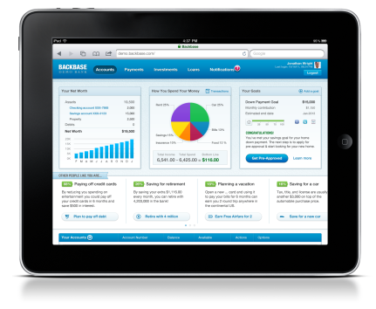
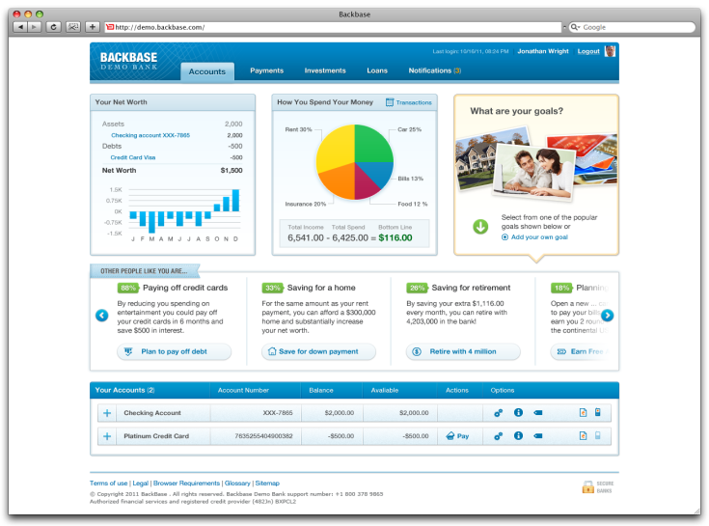


Model–View Relationship
MODEL
VIEW
Mobile
Desktop
Portal
Page
Template
Container
Template
Widget
Template
Notes:
KEY
Explain the relationship between model and view
HOW
Portal Rendering is based on Spring MVC
The Portal traverses the Portal Model and based on the template for each model node renders its presentation
Emphasize on the clear separation between model and view and the flexibility this offers
model : data / structure
view: html code
TIME
3 min

Slide 39
Item Templates
Responsive design is preferred over separate templates
For special situations, you can define specific templates to render a Portal Item
Each main device group can have its own template
Desktop (default)
Tablet
Mobile
Notes:
KEY
Template usage
HOW
These days, responsive design is preferred over separate templates, but sometimes you still need separate templates, so it is good to be aware of them.
TIME
3 min

Slide 40
Model-View-Controller Pattern
Model/view/controller (MVC) is an Architectural Pattern
Isolates "domain logic" (the application logic for the user) from the user interface (input and presentation)
permitting independent development, testing and maintenance of each (separation of concerns).
Use of the Model/View/Controller (MVC) pattern results in applications that
separate the different aspects of the application (input logic, business logic, and UI logic)
while providing a loose coupling between these elements
Notes:
KEY
MVC pattern
HOW
Give an overview of the MVC pattern
Prepare participants to the following slides. We are preparing them to understand how templates fits into the CXP world.
TIME
3 min

Slide 41
Model-View-Controller Pattern
CXP uses the Spring MVC framework under the hood and implements the model-view-controller pattern
Items belonging to the Portal Model are stored in the data store
Rendering of the model happens either client-side or server-side
Controllers are internal part of Portal Server, you do not work with them directly
Notes:
KEY
MVC pattern
HOW
Tell participants that, to create templates, they don’t need to know how the controller works.
They only need the data (model) to build their view (templates)
TIME
3 min

Slide 42
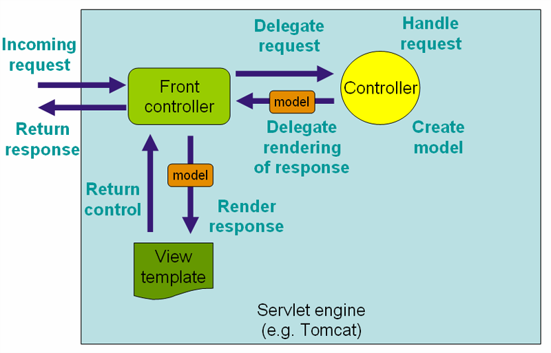
SPRING MVC
SPRING MVC
Backbase CXP hides complexity of MVC
You only create portal model and write view templates for each portal item
Portal model
item
Notes:
KEY
Spring MVC and the Front Controller pattern
HOW
Explain how the Front Controller pattern works
Emphasize that template designers should know how it works, but the overall flow is managed by CXP, they only need to create the template
TIME
3 min

Slide 43
Portal Rendering Flow
Model preparation
Security settings
Inheritance and customization
Template selection
Based on recognized device
Template Execution
Portal server calls selected templates and injects ${item} variable
${item} contains data about the item and its children
Notes:
KEY
Explain the rendering flow
HOW
CAUTION: VERY IMPORTANT TO HIGHLIGHT
Difference between Widget TEMPLATE technologies and widget CONTENT/FUNCTIONALITY technologies:
Widget template == any java based
Widget content/functionality == any technology (PHP, .NET, JSP, etc)
TIME
3 min

Slide 44
Portal Rendering Flow
Template file rendering
template file 1
${item}
template file 2
${item}
template file 2
${item}
Recognize Device
Template selection per model
Portal Templates
User Credentials
Authorization & Customization
User Customization
Initial portal model selection
Portal Database
Notes:
KEY
Explain the rendering flow using the animation
HOW
Access portal database and extract initial portal model
Apply security settings
Apply user personalization
At this point, we have the final model, we now need to select the appropriate template for each item based on the current device
Template execution phase : renders and returns the html
TIME
5 min

Slide 45
Inheritance and Personalization / Properties
Item
Inherited Item
Customized Item
${item}
Property 1
Property 1
Property 2
Property 2’
Property 2”
Property 2
Property 2’
Property 2”
Property 3
Property 3
Property 4
Property 4
Notes:
KEY
Show the inheritance and personalization of properties
HOW
Tell participants that this is the standard mechanism for property management and it is applied in all CXP scenarios.
To grab participants attention, use an example to explain the mechanism (e.g. transaction widget, column
items with three properties, namely p1, p2 and p3 (ie: columns = 2 for a container)
an inherited item gets p1 & p3 from item, p2 is overwritten, p4 is added
a user changes the value of p2
in the end, we get p1 & p3 from item, p2 from user and p4 from inherited item
TIME
5 min

Slide 46
Template Selection Process
Portal Foundation first checks if the DefaultDevice portal property is set. If it is, Portal Foundation looks for a template property with a matching name.
Portal Foundation tries to match the User-Agent header of the request against the device recognition configuration.
Portal Foundation looks for a property named DefaultDevice in the template object. DefaultDevice currently only accepts a value of Web: Portal Foundation looks for a template property named Web:
Once a template property matches, Portal Foundation tries to find the template file with the name specified in the matching property.
1. Portal default device
2. Device
recognition
3. Template default device
4. Find template
Notes:
KEY
Show how the template selection works
HOW
For more details: https://my.backbase.com/docs/product-documentation/documentation/portal/5.6.2/rendering_templateselection.html#/list
TIME
5 min

Slide 47
Template Selection: Device Config
Device recognition:
If the User-Agent header matches a device, the device configuration specifies a device type and a fallback device type
Device type:
Portal Foundation looks for a template property with name matching the device type
Fall-back device type:
Portal Foundation looks for a template property with name matching the fallback device type
<device type="iPhone" fallbackTypes="Smartphone">
Notes:
KEY
Show how the device configuration
HOW
If the client does not match a device in the device recognition configuration, Portal Foundation moves to the next step, otherwise skips to Step 4.
TIME
2 min

Slide 48
Template Selection: Model
Page
web
page.jsp
Container
web
container.soy
tablet
container_tablet.soy
Widget 1
Widget 2
web
smartphone
web
smartphone
widget-1.jsp
widget-1-mobile.jsp
widget-2.jsp
widget-2-mobile.jsp
Notes:
KEY
Show how the template selection works
HOW
Default device is web (desktop)
What happens when we view our portal page from a desktop computer?
looks at page template first
then containers
then widgets
If template for recognized device is available, it picks that, otherwise it picks the web template as a fallback
TIME
2 min

Slide 49
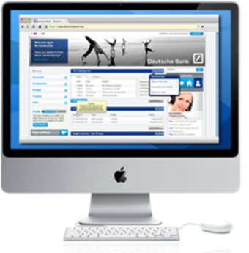
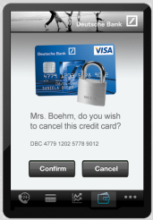
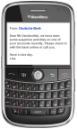
Template Selection: Desktop (web)
(default = web)
page.jsp
Page
web
page.jsp
web
container.soy
Container
container.soy
tablet
container_tablet.soy
Widget 1
Widget 2
web
smartphone
web
smartphone
widget-1.jsp
widget-1.jsp
widget-1-mobile.jsp
widget-2.jsp
widget-2-mobile.jsp
widget-2.jsp
Notes:
KEY
Show how the template selection works
HOW
Ask participants: What happens when we view our portal page from a desktop computer?
TIME
1 min

Slide 50
Template Selection: iPad (tablet)
(default = web)
page.jsp
Page
web
page.jsp
Container
web
container.soy
tablet
container_tablet.soy
container_tablet.soy
Widget 1
Widget 2
web
smartphone
web
smartphone
widget-1.jsp
widget-1.jsp
widget-1-mobile.jsp
widget-2.jsp
widget-2-mobile.jsp
widget-2.jsp
Notes:
KEY
Show how the template selection works
HOW
Ask participants: What happens when we view our portal page from a tablet?
TIME
1 min

Slide 51
Template Selection: Android (smartphone)
(default = web)
page.jsp
Page
web
page.jsp
web
container.soy
Container
container.soy
tablet
container_tablet.soy
Widget 1
Widget 2
web
smartphone
web
smartphone
widget-1.jsp
widget-1-mobile.jsp
widget-1-mobile.jsp
widget-2-mobile.jsp
widget-2.jsp
widget-2-mobile.jsp
Notes:
KEY
Show how the template selection works
HOW
Ask participants: What happens when we view our portal page from a smartphone?
TIME
1 min

Slide 52
Server Side & Client Side Rendering
Each item can have separate templates for server-side rendering and client-side rendering
Server-side rendering
Viewable content is completely generated at the server-side, browser can directly render it
Client-side rendering
Server does not create viewable content but sends to the client data to be rendered
Rendering is done by client Javascript code that directly updates client page DOM
Notes:
KEY
Explain the difference between server-side rendering and client-side rendering
HOW
SSR: Better for accessibility (new accessibility standards for rich applications not as relevant) and SEO
CSR: Client takes load from server
TIME
1 min

Slide 53


Composing the View
Portal Server
SSR
Complete View
PAGE
CONTAINERS
WIDGETS
Internet
Portal Client
Notes:
KEY
SSR
HOW
Everything is rendered server-side, including the final HTML
HTML is sent back to the end user and shown on the page
in SSR, you can use caching mechanisms to speed up the rendering
TIME
1 min

Slide 54
Composing the View
Portal Server
CSR
Partial View
PAGE
Internet
Portal Client
Completed View
CONTAINERS
WIDGETS
Notes:
KEY
CSR
HOW
The head section of the page is rendered on the server and sent back to the portal client component
Portal client lib will take over to render containers and widgets (by analyzing the portal model) and show the final HTML to the end user
in SSR, you can use caching mechanisms to speed up the rendering
TIME
1 min

Slide 55
Templating Technologies
Templates of nodes can be implemented with different templating technologies
Pages and Containers:
Google Closure — extension is soy
Java Server Pages — extension is JSP
Widgets:
JSP, Mustache
Notes:
KEY
Templating technologies
HOW
TIME
1 min

Slide 56
Key Elements of Backbase CXP
A component model
Flexible rendering and support for multi-device delivery
Personalization
The ability to integrate with a wide range of technologies
Content services
Security administration
Targeting
Publishing
Notes:
KEY
Briefly explain the table of contents
HOW
Explain that we are going to a new subject that covers the ability give users control over there user experience
TIME
1 min

Slide 57
Portal Personalization
Portal Essentials

Slide 58
Personalization
Personalization - the process of tailoring applications to individual users' characteristics or preferences
Users can change Widget properties
User space
the space of properties that user can change (not all properties are available in user space)
stored separately for each user (each user has its own space)
Notes:
KEY
Introduce the concept of personalization
HOW
Explain what personalization is and be prepared to share examples of usage.
In technical terms, personalization in CXP is the inheritance from the original item, applying the customization delta defined by the end user
TIME
1 min

Slide 59
Personalization: The Baseline is Portal
Catalog
W
W
W
W
P
C
C
W
C
W
Notes:
KEY
Use the animation to explain personalization
HOW
Explain that, during design, a widget is selected from a catalog and inserted into the page. This widget instantiated in the page can have different property values and also new properties.
In this animation:
we have a page with three containers and two widgets
we add a widget on which we want to enable personalization
TIME
2 min

Slide 60
Personalization: Extending Global Model User Model
Base Elements (eg. Widgets/Templates)
W
W
W
Widget is extended with the changed preference
P
User changes a preference
C
W
W
The user model is therefore the delta of
the Global model
C
W
“Cascading” resolving of properties values
C
W
Notes:
KEY
Use the animation to explain personalization
HOW
Explain that:
When a user personalizes this widget, a new item will be created in the user space, storing only the delta (changes from the original item)
Not only preferences can be customized, but also layouts (by drag & dropping widgets in different container areas, for example)
you cannot personalize pages
TIME
2 min

Slide 61
Portal Definition Levels
Pages
Containers
Widgets
Portal
Catalog
Level: Portal
Multiple Users within a Portal
Pages
Level: Server
Multiple Portals
Customization
Containers
DELTA CLONE
Level: User
Single User
(logged-in/anonymous)
User Space
Widgets
Containers
DELTA CLONE
Global Space
Widgets
Inheritance
Inheritance
Notes:
KEY
Explain items and their scopes
HOW
Overview of portal model in terms of personalization (Global space VS user space)
One thing we don’t cover much is that technically, containers can also be treated like widgets and personalized.
CXP objects support personalization in three levels:
server
portal
user
This means objects can be defined for:
multiple portals
multiple users within one portal and
for a single user
Whenever an object is defined for a new level, the data store makes a copy of the original
object and only stores the changes DELTA CLONE to the original.
Catalogs logically groups objects, e.g. a catalog with news widgets. It can contain any object that extends com.backbase.portal.foundation.domain.conceptual.Item.
Inheritance vs Customization
The Backbase CXP object model uses inheritance & customization extensively.
Inheritance: When a business user (cxp manager) places a widget on a page from the catalog, Backbase CXP Foundation creates a new widget that extends the widget in the catalog. The new widget inherits all attributes from the extended widget.
Customization: Similarly, when an end user personalizes an object, Backbase CXP Foundation copies the original object and applies the personalization to the copy.
An example of a personalization is moving a widget to another location on the page.
In both cases, extensions and personalizations, Backbase CXP only saves the changes (DELTAS) and not the inherited attributes.
This makes the Backbase CXP object model scalable and efficient.
TIME
5 min

Slide 62
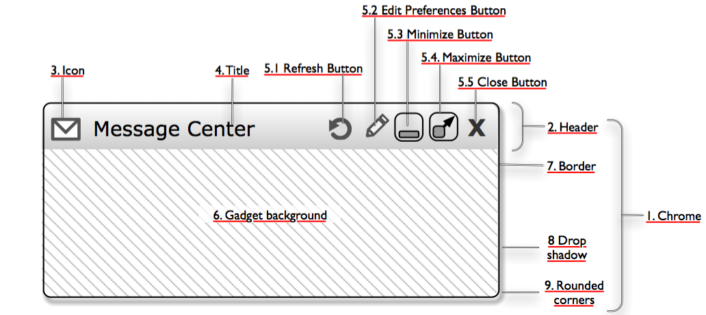
Widgets: Chrome
Notes:
KEY
Explain the concept of chrome
HOW
Chromes allow you to visually configure your widget.
Chromes themselves can be customized, there are various default chromes available (including ‘no chrome’, which is a chrome with no styling)
Chromes typically give end-users the ability to manage a widget, but developers can restrict that (preferences ‘view hint’ or JavaScript)
Preferences provide cross session storage space for authenticated users
TIME
3 min

Slide 63
Demo: Personalization
Lets look at how the CXP Manager handles the concepts we have just discussed
Notes:
KEY:
Present a demo or propose an exercise to cover the personalization feature.
HOW:
Propose a use case using personalization. This use case uses the Video widget as an example of properties personalization. The videoId property will be exposed to end users so that they can personalize the initial video to be exhibited when the page is loaded.
Proposed Steps for a Launchpad-based setup
Update the Portal catalog:
Open the previously created portal
Add the Video widget items into the Portal Catalog
Page creation
Create a new page (suggested name is My Videos)
Inside the page, add a container with three columns
Add a Video widget into the first column, with the following properties
Source: YouTube
Original Height: 400
Video ID: OI3XGVK7dYQ
Original Width: 400
Enable chrome
Go to the explorer (left-hand side menu)
Find the widget that had been just added into the page
Portals > Personalization > Items > your-page-name > Manageable Area > Columns > Video
Change the property value of widgetChrome to use the following value
$(contextRoot)/static/backbase.com.2012.aurora/html/chromes/widget_default.html
Change the property called videoId, and make the following changes to the viewHint field:
Remove the tag DesignModeOnly. Now the property can be changed during runtime
Change the tag admin to user. Now the property can be personalized by users
Changing permissions:
Go back to your page and change the columns container permissions so that users can personalize the content
Testing changes:
Open the page using a regular user account (e.g. user/password)
Using the chrome, edit the widget preferences. Change the video ID to PtWeqZsuzpE
Open the page using another type of user (manager for example)
Check the video (must be the same based on factory settings)
Open the page using the previous user
Check the video (must be your personalized video)
For a Widget Collections 2.x setup, you can use the Places widget and personalize the zoom property, for example.
TIME:
Approx. 15mins.

Slide 64
Key Elements of Backbase CXP
A component model
Flexible rendering and support for multi-device delivery
Personalization
The ability to integrate with a wide range of technologies
Content services
Security administration
Targeting
Publishing
Notes:
KEY
Briefly explain the table of contents
HOW
Explain that we are going to a new subject that covers the ability to integrate with heterogeneous systems
TIME
1 min

Slide 65
Enterprise Integration with Camel
Portal Essentials

Slide 66
Integration Services
Challenges
Data integration
Web Services
REST
Messaging
Proprietary API
HTML integration
Proxy
Screen scraping
Caching data
Filter and transform data
Convert POJO’s to JSON
Combine data sources
Renditions
PDF
Excel
HTML
Route messages
Send messages to different targets
Based on payloads
Or other rules
Notes:
KEY
Enterprise integration
HOW
Explain why we need to integrate systems. Be prepared to provide examples from your past experience.
TIME
3 min

Slide 67
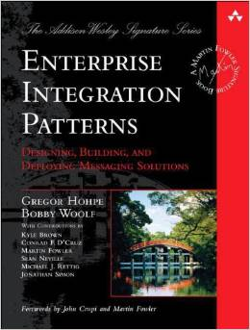
Enterprise Integration Patterns
Patterns
Provide guidance
Common language
Outlines solutions to common challenges
65+ patterns
Available platforms
Spring Integration
Mule ESB
Apache Camel
Commercial offerings
Notes:
KEY
Enterprise integration patterns
HOW
Ask participants to give examples of integration. Tell them that most of integration problems and solutions are recurrent.
The book cover is a famous book with a catalog of patterns. Spring Integration / Camel are based on those patterns
TIME
3 min

Slide 68
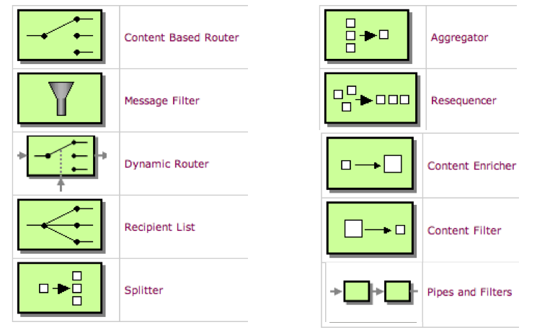
Enterprise Integration Patterns
http://camel.apache.org/eip
Notes:
KEY
Some examples of integration patterns
HOW
Give some examples of patterns and how they can be used.
TIME
5 min

Slide 69

Apache Camel
Light weight integration library
Kind of an embedded ESB
Enterprise Integration Patterns
Domain Specific Language
Routing and Mediation
Components
Built in Transformers
Active Community
Easy to extend
Concise
Application
Messaging
Exchange
Language
Notes:
KEY
Present Apache Camel
HOW
ESB : enterprise service bus
Domain Specific language: all these routes using those patterns can be specified using a DSL (java or xml/spring), other DSLs available
Point to my.backbase.com for docs on DSLs
Camel Components: endpoint factories (like gulp plugins)
TIME
3 min

Slide 70
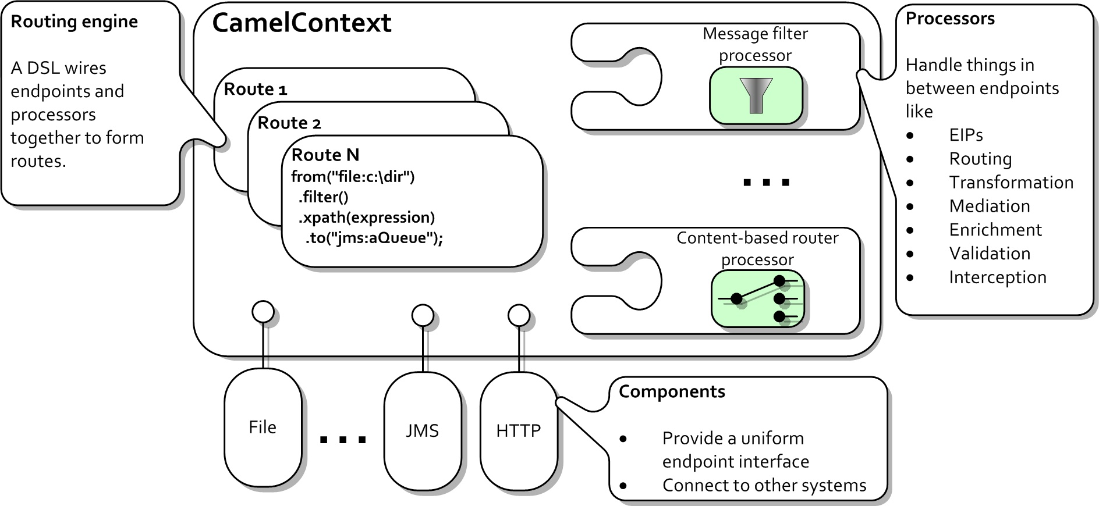
Apache Camel
Notes:
KEY
Apache Camel overall architecture
HOW
Discuss terms on slide and then zoom in on the terminology used in Camel
TIME
3 min

Slide 71

Apache Camel In CXP
WOA
Widget
Widget
Widget
ASYNCHRONOUS
RESTLET
RESTLET
Portal Server
Integration Services
SOA
HTML Integration:
WWW
(X)HTML
Application
Data Integration:
Web Services
Web Interfaces
ROUTE
ROUTE
Existing Systems
Message Queue
Notes:
KEY
Apache Camel in CXP
HOW
Present how CXP integrates with heterogeneous systems through the Integration Services layer
TIME
3 min

Slide 72
Key Elements of Backbase CXP
A component model
Flexible rendering and support for multi-device delivery
Personalization
The ability to integrate with a wide range of technologies
Content services
Security administration
Targeting
Publishing
Notes:
KEY
Briefly explain the table of contents
HOW
Explain that we are going to a new subject that covers the content services module
TIME
1 min

Slide 73
Integration: Content Services
Portal Essentials

Slide 74
Content Services
Content Services is a content delivery platform provided as a CXP module.
Centralized Content Repository
Main functions:
Stores “In Context Editing” (a.k.a. ICE) content from CXP Manager.
Stores reusable content (potentially harvested through importers from remote sources)
Stores configuration and resources
Notes:
KEY
Define Content Services
HOW
Explain that CS is a content delivery platform, not a full blown CMS
TIME
1 min

Slide 75

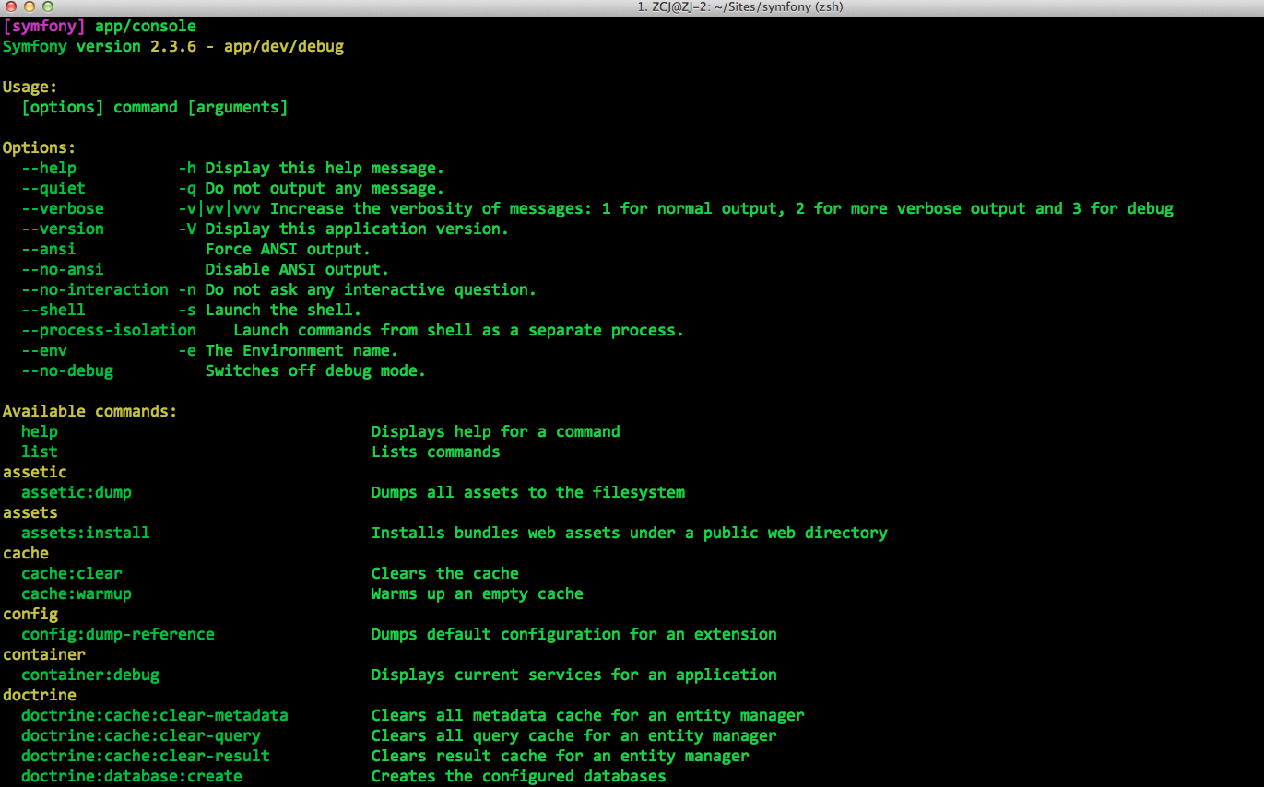
Content Services
Server
Backbase CXP Foundation
Remote
Application
Content Services
CMIS
Repositories
WebDAV
Content
Portal
JMX
File System
Portal
Portal
Configuration
Resources
Importers
Remote Content
Notes:
KEY
Describe the overall architecture of CS
HOW
Content repositories - These repositories store content used by Backbase widgets, like images and text.
Content repository — stores Shared Content that multiple portals can use. One can navigate this repository from the Shared Content app in CXP Manager.
Portal repositories — each portal has its own repository that stores ICE Content and Portal Content. One can navigate this repository from the Portal Content app in CXP Manager.
Internal repositories
Configuration repository — allows to configure importers that fetch remote content.
Resources repository — stores imported catalog items (when Import/Export is configured to store imported catalog items in Content Services).
Can optimize between file system storage and db storage
Can define importers to import from a remote CMS
Remote application can connect to CS through CMIS, WebDAV or JMX
TIME
3 min

Slide 76
Content Services
Content Services main features:
Content Aggregation: imports data from remote sources and stores it in repositories
Integration: exposes CMIS and WebDAV interfaces to work with content
Administration: exposes the JMX interface for monitoring
Scalability: support for clustering means that Content Services instances can be configured for a variety of backend technologies
Failover: support for clustering means that requests can be routed to different Content Services instances if one instance is unavailable
Notes:
KEY
CS capabilities
HOW
Elaborate on the slide
TIME
1 min

Slide 77
Kinds of Content Used in Portal Pages
There are two kinds of content that may appear in portal pages:
In-Context Editing (ICE) content — rich text inserted during page management. ICE Content is published implicitly as part of the page in which it resides. ICE Content is stored automatically and is not manageable.
Reusable Content — content items that can be used across different pages of the same or different portals. Reusable Content is uploaded, managed and published centrally in the Shared Content and Portal Content apps and can be referenced in pages.
Simple — uploaded media type files which can be directly referenced in pages, such as images, videos, PDFs, etc.
Structured — instances of custom Structured Content types.
Notes:
KEY
CS capabilities
HOW
Describe each content type. Be prepared to share examples.
TIME
1 min

Slide 78
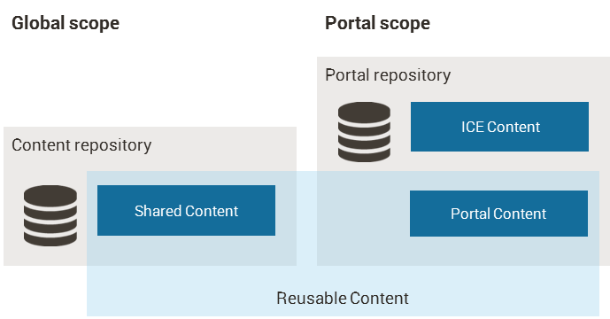
Scope of Reusable Content
Regarding scope, reusable content can be:
Shared (or global)
Portal-specific
Notes:
KEY
Describe CS scopes
HOW
Regarding scope, Reusable Content can be:
Shared (or Global) — content items which are shared and stored in the content repository. Shared Content items are managed from the Shared Content app and are available to be dragged and dropped in pages of all portals in your environment.
Portal-specific — each portal has their own repository, the portal repository, that stores Portal Content (and ICE Content). Portal Content items are managed from the Portal Content app and are visible only for users of that portal; so only available to drag and drop on pages of that portal.
TIME
3 min

Slide 79
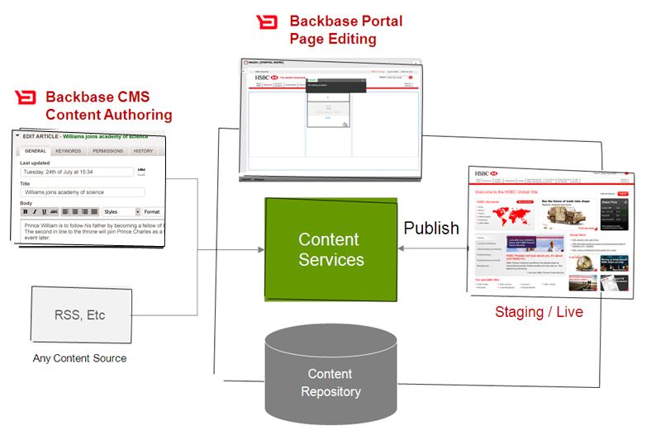
CMS + Content Services + Page Editing
CONTENT Authoring
PAGE Editing
VISITORS
CONTENT authoring
PAGE Editing
VISITORS
(Existing CMS)
(Existing CMS)
CMS
Authoring GUI
CMIS
interface
2
staging / live
CMS Content
Repository
CMIS interface
CMIS interface
Portal
Content
Repository
Portal Content
Repository
3
1
Import
Import
Notes:
KEY
CS and CXP Portal
HOW
Explain the dynamics of CS and Portal publishing
TIME
3 min

Slide 80
Key Elements of Backbase CXP
A component model
Flexible rendering and support for multi-device delivery
Personalization
The ability to integrate with a wide range of technologies
Content services
Security administration
Targeting
Publishing
Notes:
KEY
Briefly explain the table of contents
HOW
Explain that we are going to a new subject that covers the security aspect of CXP
TIME
1 min

Slide 81
Portal Security
Portal Essentials

Slide 82
Security Services
Portal Server
Local Widgets
Remote Widgets
Personalization
Services
Security
Services
Widget
Widget
Widget
Widget
Widget
Widget
Widget
Widget
Connector
Connector
SSO Service
Authentication Provider
MSAD
LDAP
SAML
OpenID
OAuth
…
...
Notes:
KEY
Give an overview about the security layer of CXP
HOW
Portal security relies on Spring security:
well-established
mature framework
a lot of connectors available (LDAP, etc..)
single sign-on feature (CAS: central authentication service)
TIME
4 minutes

Slide 83
Backbase CXP Security
Based on Spring Security
Application Level Security Spring Authentication Providers
HTTP BASIC/Digest authentication, HTTP X.509 client certificate exchange, LDAP, Form-based authentication, OpenID authentication, Automatic "remember-me" authentication, Anonymous authentication, Kerberos…,
Your own authentication systems
Additional Authentication Options for Portal Items
Advanced topic, covered in depth in a separate module
Notes:
KEY
Authentication process
HOW
2 steps:
authenticating users
authorizing users (access control list + group membership, or roles, url protection)
Do not go into too much details; explain that this is covered in-depth in Backend training.
TIME
3 min

Slide 84
Demo: Item Rights
Apply different rights to various items in CXP Manager
Use manager and admin accounts to test the differences
Notes:
KEY:
Present a demo or propose an exercise to cover the security feature.
HOW:
Propose a simple use case.
Exercise 04: Security
Group creation:
Create two groups:
premium customers
standard customers
Create a user for each group. They will be used for testing purposes
Authorization
Change the portal permission
Allow premium and standard customers to view the portal
Change your credit cards page
Add a content widget inside the second column of the columns container. This content widget will display credit card information for standard customers. The first content widget will display credit card information for premium customers.
Change the authorization
Premium customers can view the widget in the first column
Standard customers can view the widget in the second column
Test the page
Access the credit card page using a standard customer
Access the credit card page using a premium customer
TIME:
Approx. 8mins.

Slide 85
Key Elements of Backbase CXP
A component model
Flexible rendering and support for multi-device delivery
Personalization
The ability to integrate with a wide range of technologies
Content services
Security administration
Targeting
Publishing
Notes:
KEY
Briefly explain the table of contents
HOW
Explain that we are going to a new subject that covers the ability to show different content to users based on a set of rules
TIME
1 min

Slide 86
Targeting
Portal Essentials

Slide 87
Targeting
Displays pages differently depending on certain criteria, for example, the user's browser, geographic location, demographic, etc.
Targeting uses the Targeting Container, a container with multiple alternative displays
For each alternative, conditions can be specified.
Collectors collect data about the user from external sources and merge them in a user profile
Rules Engine evaluates conditions sequentially, and returns the first alternative whose set of conditions evaluates to true.
The fallback – the ”last” alternative being taken if none of the conditions evaluate to true.
Notes:
KEY
Define targeting
HOW
Describe targeting and its elements. Be prepared to give examples of usage.
TIME
3 min

Slide 88
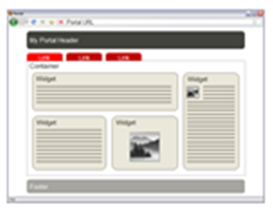
Targeting Process Flow Overview
Client
Backbase CXP
Remote Content
and Services
Backbase CXP foundation
Rules Engine
Back-end
system
Targeting
CMS
Collectors
User
Profile
Web Service
Notes:
KEY
Targeting architecture
HOW
Given a page with a targeting container on it:
portal gets request from the client
rules engine calls the targeting collectors
collectors call various remote sources
data is stored in user profile
user profile is returned to the rules engine so it can select the correct alternative
if no alternative matches the current user, the fallback is selected
You probably want to cache the user info for performance reasons
TIME
3 min

Slide 89
Demo: Targeting
Lets look at how the CXP Manager handles the concepts we have just discussed
Notes:
KEY
Present a demo or propose an exercise to cover the targeting feature
HOW
Create a targeting container with conditions based on session attributes (e.g. browser name)
Proposed Steps
Portal catalog
Add the targeting and fallback container into your portal catalog
Page creation
Create a page with a targeting container (e.g. Targeting)
Create two alternatives (e.g. Chrome, Firefox)
For each alternative, add a container with a recognizable label
Test
Test the application using different browsers.
TIME
Approx. 6mins.

Slide 90
Key Elements of Backbase CXP
A component model
Flexible rendering and support for multi-device delivery
Personalization
The ability to integrate with a wide range of technologies
Content services
Security administration
Targeting
Publishing
Notes:
KEY
Briefly explain the table of contents
HOW
Explain that we are going to a new subject that covers the publishing process
TIME
1 min

Slide 91
Publishing
Portal Essentials

Slide 92
Publishing
Backbase CXP supports publishing pages and content to different environments in a controlled manner:
Editorial environment
Staging environment
Live environment
The Orchestrator module is in charge of the publishing process.
It must be present on all environments alongside Backbase CXP Foundation.
Orchestrator locks data, sends and retrieves packages, manages approvals, and unlocks data.
Notes:
KEY
Define the publishing process
HOW
Publishing is a mechanism of Backbase CXP to control creation and migration of portals among several environments.
Backbase CXP supports publishing pages and content to different environments in a controlled manner. A typical setup has an editorial, staging and live environment.
Backbase CXP always publishes a whole page with all its containers, widgets and ICE content (if ICE widgets are used). You cannot publish individual widgets or containers.
TIME
4 min

Slide 93
Publishing
Editorial
Backbase CXP Foundation
Edit + Publish
CXP Manager
Edit
Orchestrator editorial mode
Publish
Editor
Edit
Content Services
Publish
Publish
Approve / Reject
Staging
View Portal
Backbase CXP Foundation
Orchestrator staging/live mode
Approver
Content Services
Live
View Portal
Backbase CXP Foundation
Orchestrator staging/live mode
End User
Content Services
Notes:
KEY
Publishing elements
HOW
Editorial environment
Editors work with CXP Manager to make changes to pages and publish these changes. The editorial environment requires CXP Manager and an Orchestrator in editorial mode. Only in this env do you have CXP manager.
Editorial environments support the optional Audit Trails feature.
Staging environment
An “approver” reviews updated content (read-only). While in review, data is locked to prevent any further changes. Data cannot be unlocked until content is either approved or disapproved. You cannot modify anything on staging directly, it can only be done via publishing. To approve or reject the package, approver needs to login in the editorial env.
Live Environment
What the end users see (read-only).
You cannot modify anything on live directly, it can only be done via publishing.
All three environments need to have Orchestrator running to be able to publish from one env to another. CXP Manager is ONLY available in editorial env.
TIME
5 min

Slide 94
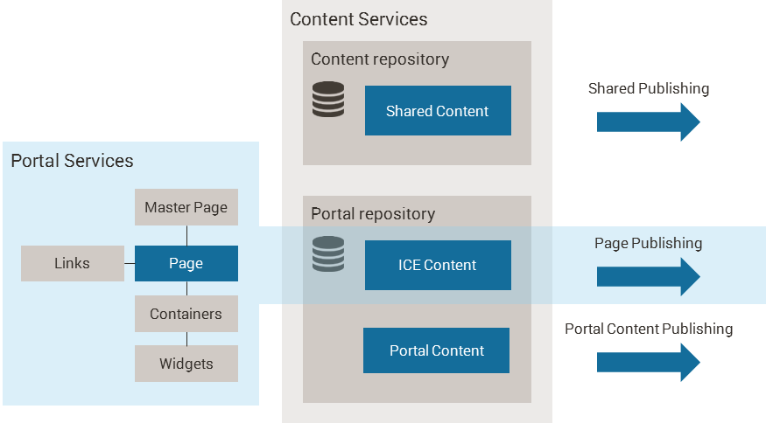
Publishing Routes
Notes:
KEY
What is part of the publishing process?
HOW
Publishing Services offers multiple Publishing routes:
Page Publishing — Publishing of links, pages, page children, master pages in the Portal Catalog, and ICE Content.
Content Publishing — Publishing of Reusable Content
Shared Publishing — Publishing of Shared Content
Portal Content Publishing — Publishing of Portal Content
TIME
3 min

Slide 95
Publishing within in an Environment
Publishing takes place across different portals instead of environments
For testing and demo purposes (configurable in the Orchestrator configuration file)
Backbase CXP Foundation
Portal
Editorial
Portal
Staging
Portal
Live
ORCHESTRATOR
editorial mode
Notes:
KEY
Demo publising
HOW
Publishing Within an Environment
For testing and demo purposes, Backbase CXP can also publish within one environment. In this scenario, publishing takes place across different portals instead of environments. This allows the use of publishing functionality without installing Backbase CXP on multiple machines. Content is not published in this scenario. This means that the editorial portal uses the same content in Content Services as the live portal.
For example, Orchestrator publishes from the editorial portal to the staging portal and from there to the live portal:
Publishing within an environment is an optional feature configurable in the Orchestrator configuration file.
Unpublishing
Unpublishing means removing pages from a portal. On staging or live environments, unpublished pages are removed from the local data store. On editorial environments, pages continue to exist in the data store of the editorial environment so that they are still available for future publishing, if needed. If you want to delete a published item, you first need to unpublish it.
Before you can unpublish a page, it needs to have completed the publishing chain. For example, if a page follows the Approval on Pages publishing chain explained above, it cannot be unpublished until it has reached the live environment, or until an approver has rejected the publishing request.
It is not possible to unpublish master pages if their derived pages are still published. To unpublish a master page, unpublish first their derived pages.
When unpublishing a page, make sure you select the correct publishing chain. For example, if a page was published to a live environment through a Approval on Pages publishing chain, unpublishing it through a Direct publishing chain will return an error.
Republishing
If you published some pages and subsequently modified them in the editorial environment, you can republish those pages with one button click in CXP Manager. This republishes all modified pages that have already been published to other environments.
The links and CMIS content related to the pages are republished as well. Republishing has the same effect as manually selecting the individual pages, but can save time and is less error-prone.
TIME
5 min

Slide 96
Security
Orchestrator has two roles that you can map to groups in Backbase CXP Foundation:
Publisher – Allows users to submit publish requests.
Approver – Allows Approvers to approve or reject publish requests.
Note that Backbase CXP enforces the four-eye principle: a user who submits a publish request may not approve it
Notes:
KEY
Security and roles
HOW
Not every user is allowed to published. Only the ones in the “publisher” group.
Only people in the “approver” group can approve packages.
TIME
3 min

Slide 97
Demo: Publishing
Lets look at how the CXP Manager handles the concepts we have just discussed
Notes:
KEY
Present a demo or propose an exercise to cover the publishing feature
HOW
Proposed script
Portals creation
Create the editorial portal with the package publish chain
Create the staging an live portals without any publishing chain (mention that they are not important because the configuration has been made in the editorial portal
Portal content
Add an image into the content repository of the editorial portal. It will be used by a master page (e.g. as a banner)
Page creation
In the editorial portal
Create a master page with:
a content widget on the top of the page (change the template property to image)
Drag the header picture into the content widget
a manageable area
Create a page that uses the master page. Add a content with an image inside.
Publishing demo
Part 1:
Mark the page to be published
Try to publish: CXP manager will warn you that the master page needs to be published first.
Part 2:
Mark the master page to be published
Try to publish: CXP manager will warn you that the banner needs to be published first.
Part 3:
Mark the banner to be published
Try to publish: Pages will not be published
Ask participants why the page has not been published ?
Give them some clues about the difference between the widget development and publishing lifecycle
To wrap up, explain that widgets and containers are not part of the publishing process and IT is responsible for maintaining the catalog in all environments.
In this particular case, both staging and live catalogs are out-of-sync
Part 4:
Go to the portal catalog of staging and live portals and add all containers and widgets used by the page and master page
Publish again
Validation
Open the staging portal and show the newly created page
Approval
Login to CXP manager using a different user with approval rights (e.g. manager)
Go to the portal publishing
Approve the package
Usage
Demonstrate the page in the live portal
Some considerations
if you restore an older version, you will need to republish it
you cannot delete published pages before un-publishing them first
TIME
20 min

Slide 98
Key points
Portal has an item based component model
Personalization
Content services
Rendering per item, per device
Security administration
Powerful integration mechanism
Targeting
Publishing

